Slide 1
I want to work out regularly
But that’s hella difficult

Slide 2


Am I motivated? KINDA!
I want to work out regularly, but I’ve been stuck with another motivation to NOT work out, I don’t like how I feel after a workout, which is a pretty strong sensation motivator.
So I have to motivators crashing against each other:
A sensation motivator to not workout and
An anticipation motivator to workout
The sensation motivator is much stronger

Slide 3
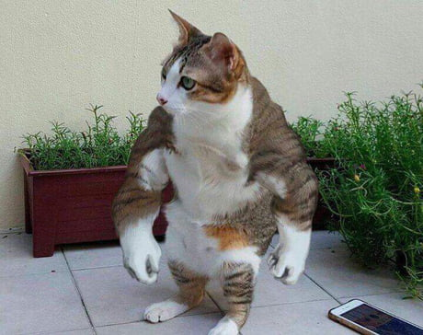
How do I solve this?
No clue
After thinking about it, I think I need to just make it routine, it’s like brushing my teeth, if it doesn’t happen I feel odd
I could also workout with friends, but our schedules would have to align for that to work
Reward myself not for each day, but for a consistent streak (For that habit building)

Slide 4
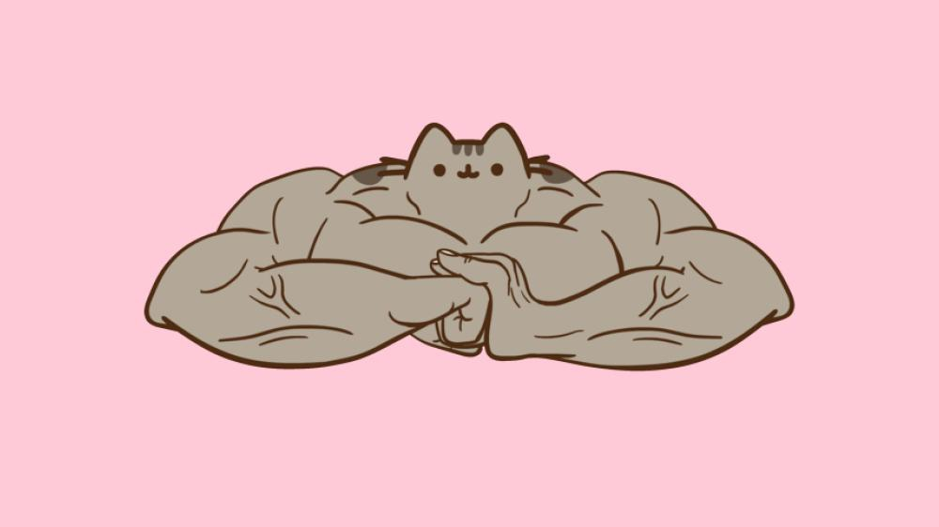

Specific behavior I’m adding?
Working out 5 days a week
Mon-Fri
Arm, Core, Leg, Arm, Core

Slide 5
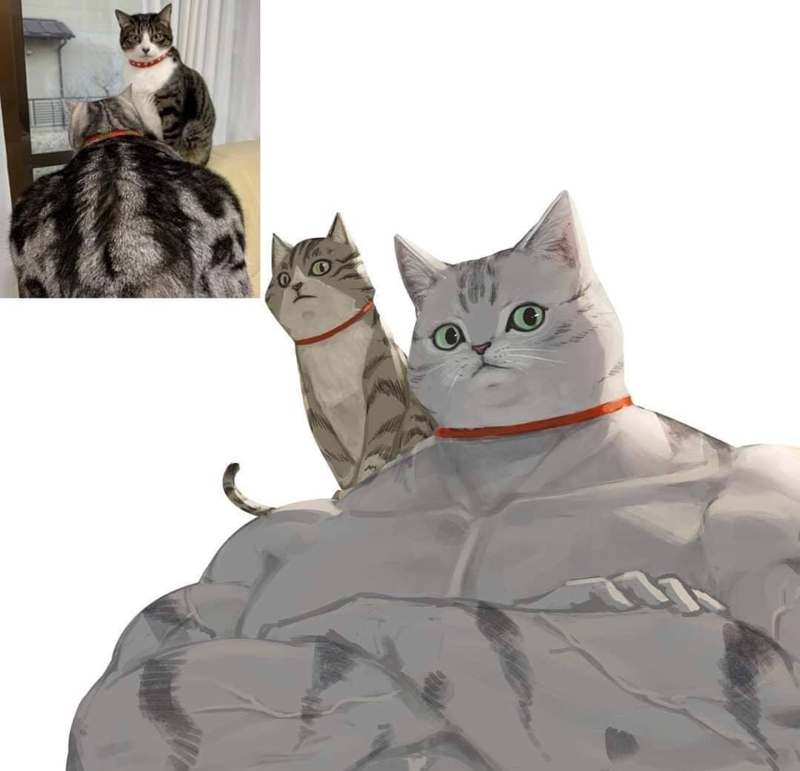
Do I have the ability?
Physically? Yes
You can always workout smaller but with more reps if something is too difficult
Time Management? I need assistance with this part
I don’t know how to balance this with work and social life
Money? Yes
I like bodyweight exercise so that’s free
Mentally? I think so
Social Deviance?
There isn’t any

Slide 6
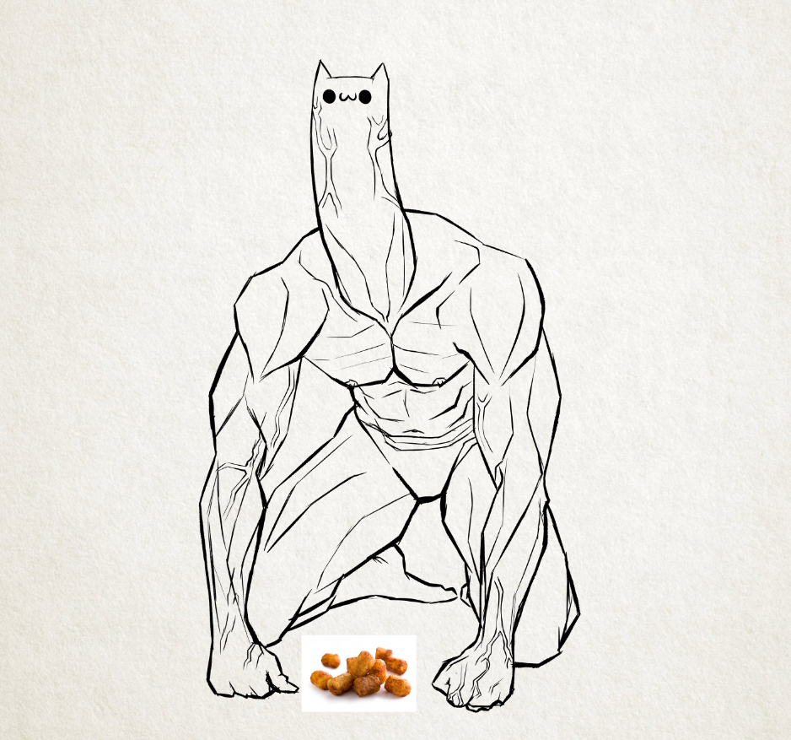
How do I trigger myself to workout?
Make it part of my routine!
Where do I put it in my routine?
I could limit some form of food eating behind working out

Slide 7

In conclusion
I know what I want to do
I know why I am not doing it
I have ideas to solve this in theory
All that is left is execution

